Slide 1
Improving Empirical Antibiotic Prescribing in the Emergency Department Through Artificial Intelligence to Predict Multi-drug Resistant Organisms
10/7 Meeting Notes

Slide 2
Upcoming Dates
10/8 Tue (Tomorrow!) – Project details and steps needed to access datasets
10/30 Wed – First meeting with course staff
11/6 – Team Presentations on Project and Work Plan
11/8 – Written proposals due

Slide 3
10/7 Goals
Discuss dataset access
Background reading – discussion and questions

Slide 4
Dataset
Status of adding members to IRB protocol?
Data access and storage – via SAFE Desktop?
Version control – via Git
https://github.com/chloesheen/PCM-F24-MDRO.git

Slide 5
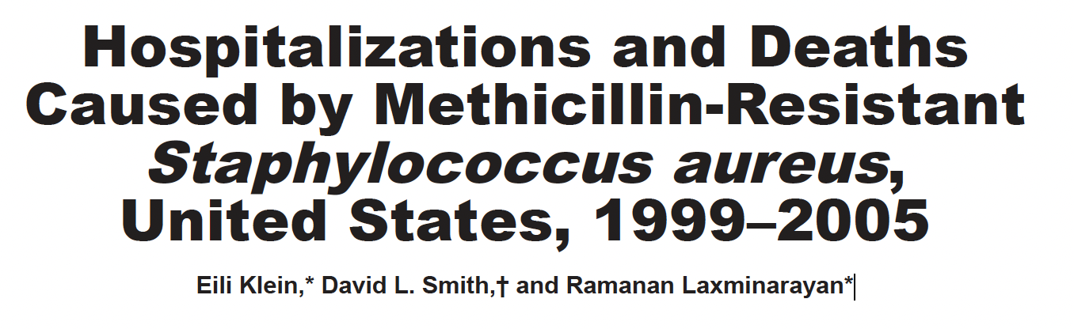
Summary
The authors tracked S. aureus-related hospitalizations by taking information from the National Hospital Discharge Survey, which reports up to 7 diagnoses for each patient. Each patient was counted as a S. aureus-related infection if any of the 7 were S. aureus related, and each patient was counted as a S. aureus death if they died and the primary diagnosis was S. aureus related. Some correction was then done to account for biased/under reporting. The Surveillance Network, which takes susceptibility data from several labs, was used to characterize the proportion of S. aureus infections that were methicillin resistant. Over the study period, S. aureus related hospitalizations increased by 62%, and methicillin-resistant hospitalizations more than doubled. Deaths remained stable.

Slide 6
Questions
Q: Given the rise in S. aureus infections without a corresponding rise in deaths, were any screening changes made during the study period that could have resulted in increased reporting of S. aureus infections that were already present?

Slide 7
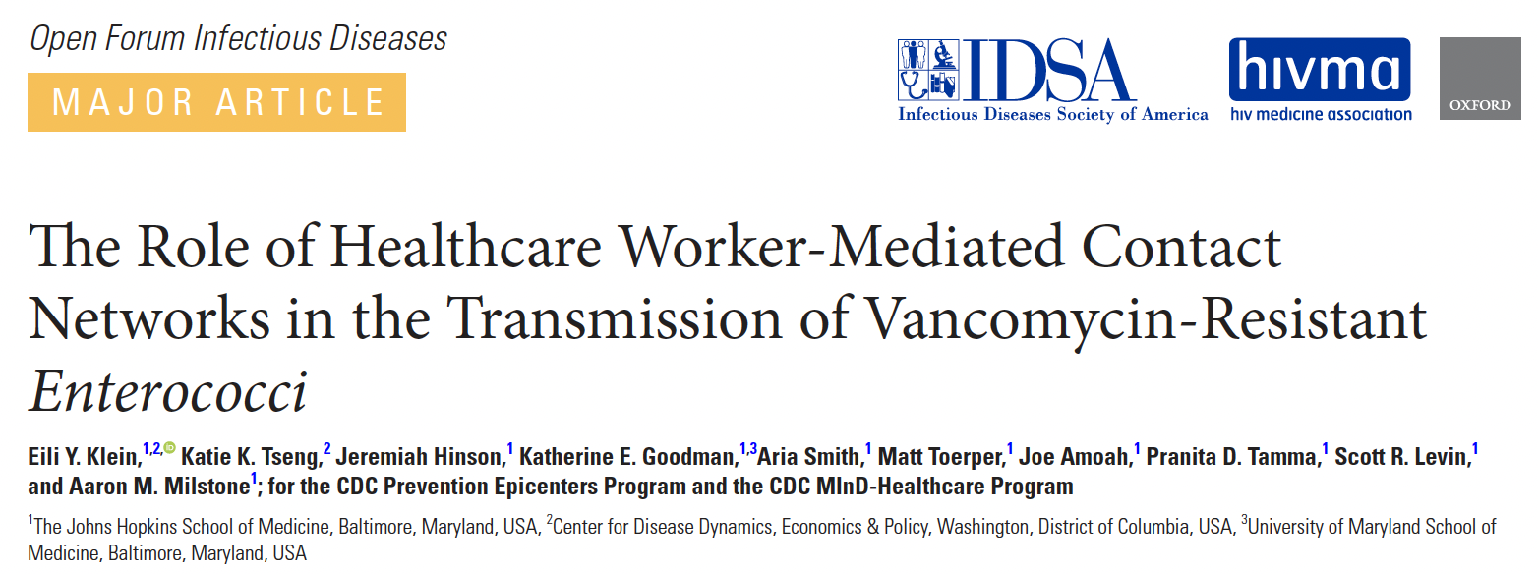
Summary
This study sought to evaluate the role of HCWs in the transmission of VRE. Data was extracted from the EHR. Contacts by an HCW with 2 different patients within 1 hour was considered a “connection”. Incident VRE acquisition was determined by positive clinical or surveillance cultures collected ≥72 hours after a negative surveillance culture. Patients that acquired VRE had a higher average daily connections to VRE-positive patients. (Although it seems it is well within the margin of error...)
Key Insight: Since an HCW could administer multiple medications or conduct several activities within a short period of time, the authors combined all events that had separate line items in the EHR from a single HCW that occurred within 10 minutes of each other and counted them as a single contact by that HCW with that patient. (I.e., if a HCW had more than 1 contact with patient A, even after combining events that occurred within 10 minutes of each other, in the hour preceding contact with patient B, this was counted as a single connection). We can use the above to count a "contact".

Slide 8
Questions
Q: What's the incubation time after high exposure to an MDRO? Let's say a patient enters the ED, and within 2 hours is confirmed with an MDRO; would that MDRO be from the clinic or from outside the ED?
Q: The paper counted many interactions as one contact, but I would assume that time spent by the bedside plays a role. (I.e., some procedures can take longer than others). How do we take this into account? Is it labeled in the EHR?
Q: Apart from contacts, the incident VRE group had higher proton pump inhibitor and antibiotic usage in the hospital. How would we distinguish between an infection due to contact versus these other factors?

Slide 9
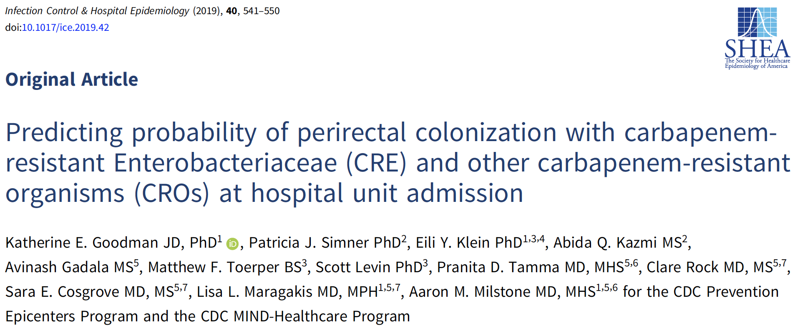
Summary
The study aimed to predict the likelihood of patients being colonized with carbapenem-resistant Enterobacteriaceae (CRE) and other carbapenem-resistant organisms (CROs) at hospital unit admission using machine learning methods. Patients admitted to the Medical Intensive Care Unit (MICU) and the solid organ transplant (SOT) unit at Johns Hopkins Hospital (including 2979 admission swabs from 2165 patients) were screened through perirectal swabs for the presence of CROs and carbapenemase-producing organisms (CPOs). Over 125 clinical and demographic variables from electronic medical records (EMRs) were used to develop predictive models, with decision tree models constructed using the CART algorithm. Internal validation was performed through leave-one-out cross-validation, and logistic regression was used to analyze the relationship between covariates and colonization status.
Despite including known risk factors for CRO and CPO infection, the models had low predictive accuracy, likely due to patient and significant host/organism heterogeneity, the models reflecting relative rather than absolute risk, and missing data on community exposures and outpatient care. While the decision tree models failed to predict colonization accurately for the broader population, they were able to identify high-risk patient subgroups (patients with CRO in some subgroups (such as CRO positive history and PPI users) with greater precision.

Slide 10
Questions
Q: How can we better address the distinction between relative risk and absolute risk of infection in our model, and is this challenge partly mitigated by Aim 1's focus on improving the definitions of prior connections with MDROs?
Q: How should we approach the issue of nontraditional exposures and “community reservoirs of resistance”? Should this be a significant concern, and what strategies might we consider to address it effectively?
Q: This study considered clinical application of the algorithm. For Aim 2, should we consider the final output of our algorithm to the users, and if so, what kind of output can be suitable?

Slide 11
Supplemental slides

Slide 12
Aims
Aim 1: Prior connections to patients with an MDRO is a major risk factor, but defining these connections and the optimal risk is unknown. Evaluate data on the risk of a connection, defined as prior room occupancy by a patient PCM RFP – 2 with an MDRO, or prior HCW connection to someone with an MDRO within a certain amount of time (e.g., 30-60 min). Assess optimal look-back time frame and factors associated with connections.
Aim 2: Develop a machine learning algorithm (MLA) that identifies a patient’s risk for MDRO infection using electronic health record (EHR) data, including prior connections data. This algorithm will be derived and tested outof-sample using ED encounter data from six hospitals within the Johns Hopkins Health System.
Aim 3: Create a federated learning environment to predict the risk of MDRO infection at each hospital using the same model but with separate and segregated data for each hospital. Evaluate difference between overall result and federated learning result.

